Slide 1

NEXT WORD PREDICTION USING RNN
Name:P.Tamilarasi
College Name:Panimalar Institute of Technology,
Degree:B.Tech
Branch:AI-DS
EMAIL:tamilarasipandiyan02@gmail.com
Naan Mudhalvan ID:AU211521243165

Slide 2


TITLE
NEXT WORD PREDICTION USING RNN

Slide 3

AGENDA
PROBLEM STATEMENT
PROJECT OVERVIEW
WHO ARE THE END USERS
YOUR SOLUTION & ITS VALUE PROPOSITION
THE WOW IN YOUR SOLUTION
MODELLING
RESULT

Slide 4

PROBLEM STATEMENT
Using recurrent neural networks (RNNs), design a next word prediction system that is capable of predicting the most unlikely word by using an assortment of words that have come prior to it. The model should be prepared to identify the contextual links between words given a massive corpus of text data, and it should be able to produce insightful predictions based on patterns found in the training data. Taking into account both syntactic and semantic coherence, a system should be able to handle variable-length input chains and anticipate the word that comes next with high accuracy. The model's performance should be assessed with indicates like accuracy or perplexity, and regularity and the hyperparameter tuning should be investigated to maximise the model's capacity for forecasting while limiting overfitting.

Slide 5

PROJECT OVERVIEW
Next word prediction systems can help users type more quickly and accurately by reducing the amount of text they need to input manually. They can also improve user experience in applications by providing contextually relevant suggestions and anticipating user intentions. so, here we use RNN technique to predict the word that is in email and other

Slide 6

WHO ARE THE END USERS
Text Editors and Word Processors Users
Mobile Device Users
Language Learners
Assitive Technology Users
Chatbot and Virtual Assistant Users
Search Engine Users
Programming Tools Users
Content Creation Platforms Users

Slide 7
YOUR SOLUTION & ITS VALUE PROPOSITION
Software tokenizes text data into words or subwords, interprets it into mathematical drawings, and creates RNN model training input-output pairs. An RNN will form the system's core. The model learns information dependencies and predicts the next word. . Teaching the model to detect the next word from previous words. Backpropagation and superior techniques like SGD or Adam over training update model parameters. Assessment tool evaluates trained model. Measure the model's ability to predict the next word in unseen text data using perplexity, accuracy. The neural network technique can be deployed as a service or used in next-word prediction applications through testing and assessment.
Use an RNN architecture best matches the challenge and computational resources. Create an RNN model that takes word embedding sequences and outputs the vocabulary probability distribution for next word prediction. Dropout the regularising decreases overfitting and promotes applicability. Split the data into training, validation, and test. Train the RNN model using the training data, decreasing a loss function that quantifies the difference between predicted and actual next words. On the test set, evaluate the trained model using perplexity, accuracy. Check produced word sequences while contrasting anticipated and actual next words as you assess the model's predictions. TensorFlow Feeding or Flask may serve the trained RNN model. Provide real-time next word predictions in editors for words, virtual keyboards, even chatbots.

Slide 8
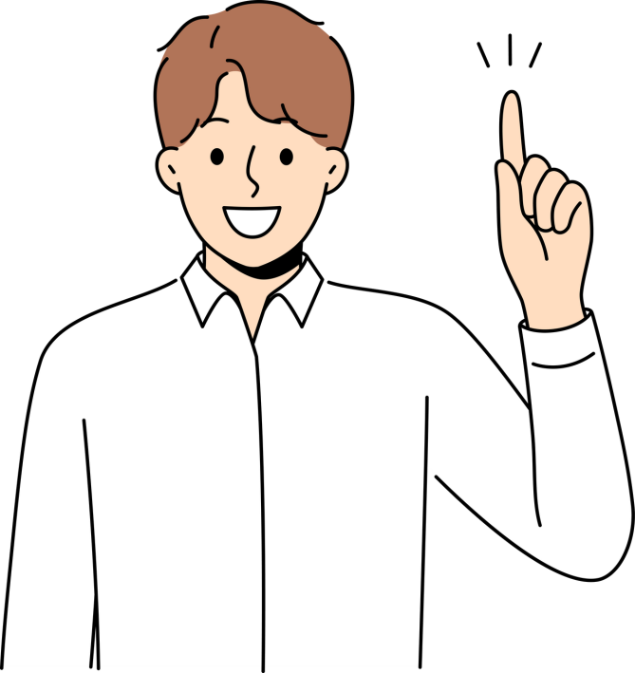
wow in your solutions
Encode input text into words, make input-output sentence cycles, and encode
characters into digits.Use an RNN architecture for sequential data forecast.
Adapt the RNN model to decrease prediction errors on a huge text corpus applying input-output pairs.Using a validation dataset to judge the trained model's accuracy and perplexity. Based on validation results, adjust
hyperparameters and model architecture to maximise performance. Assess the trained the RNN neural network for forecasting the next word in real-world applications with variable-length input sequences.

Slide 9
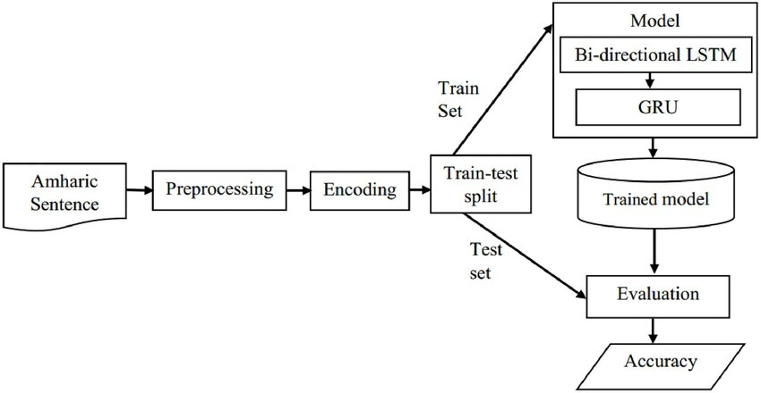
MODELLING

Slide 10

RESULT
The prediction of the word is easy by using Recurrennt Neural Network Technique.Implementing this model in a loop and analysing its internal place is a simple way to generate text. Each model call involves text in a hidden state. The model predicts subsequent character and state.

